Slide 1
Weekly meeting 13
Shengya Guo, CR/AVS3, 27.09.2024

Slide 2
Turn in to use of Pythorch
Bad Performance with self bulid Tensorflow PPO
Use the PPO script which already been tested online.
Test the basic performance with Pendulum, succussed
Also need to update my EMB model with autograd function in to Pytorch version

Slide 3
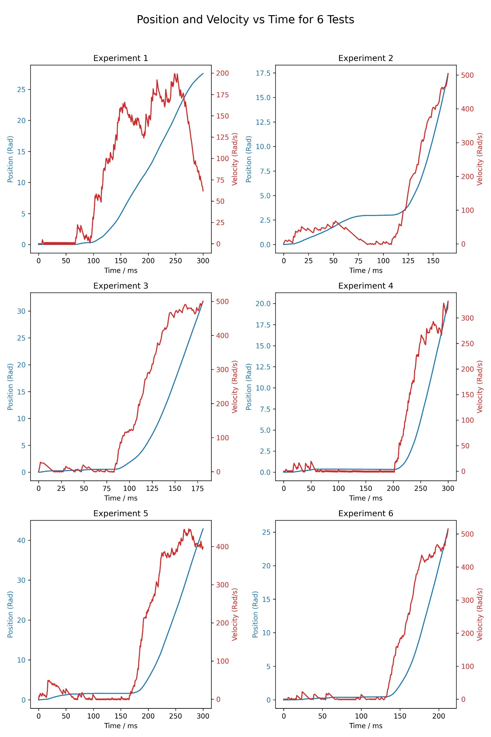
Train the EMB model in the new PPO
Obs = [x1, x2, k , FIM]
Fixed nominal fv used for the reward calculation
Why does the EMB wait and the velocity vibrate at the beginning?

Slide 4
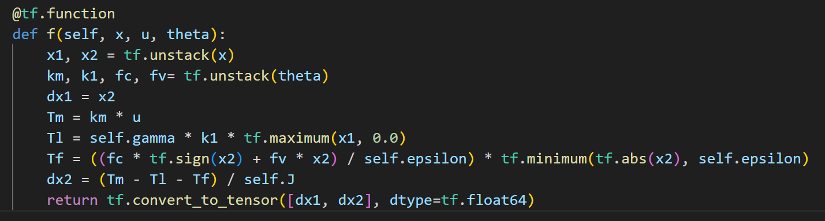
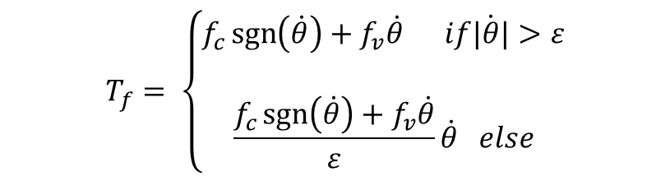
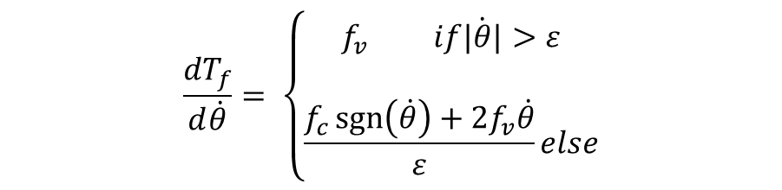
Reason
$$T_{f}= \left\{\begin{aligned}f_{c}\operatorname{sgn}\left(\dot{θ}\right)+f_{v}\dot{θ} if\dot{|θ|}&>ε \\ \\ \frac{f_{c}\operatorname{sgn}\left(\dot{θ}\right)+f_{v}\dot{θ}}{ε}\dot{θ} else\end{aligned}\right.$$
$$\frac{{dT}_{f}}{d\dot{θ}}= \left\{\begin{aligned}f_{v} if\dot{|θ|}&>ε \\ \\ \frac{f_{c}\operatorname{sgn}\left(\dot{θ}\right)+{2f}_{v}\dot{θ}}{ε}else\end{aligned}\right.$$
fc = 10.37e-3
fv = 2.16e-5

Slide 5
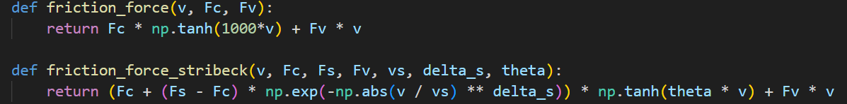
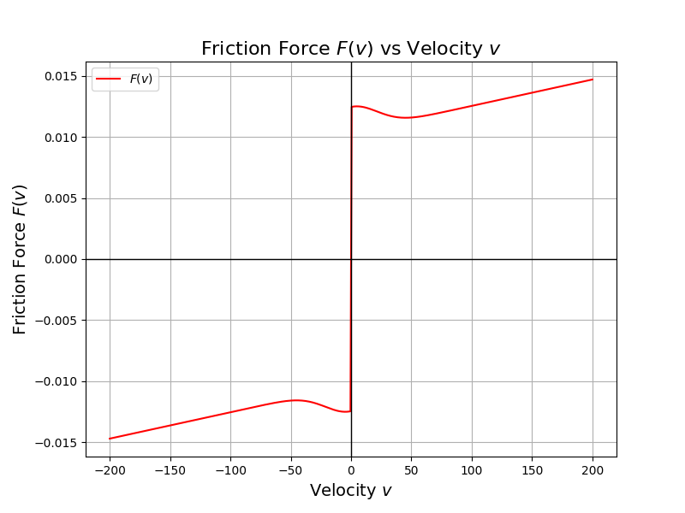
Correct the friction model
Tf = fc * torch.sign(x2) + fv * x2

Slide 6
Problem with Observation normalization
The mean und var will loss when running the test episode after training
The test will continuous with the mean and var from the training, need to save this value and load them after load the mode

Slide 7
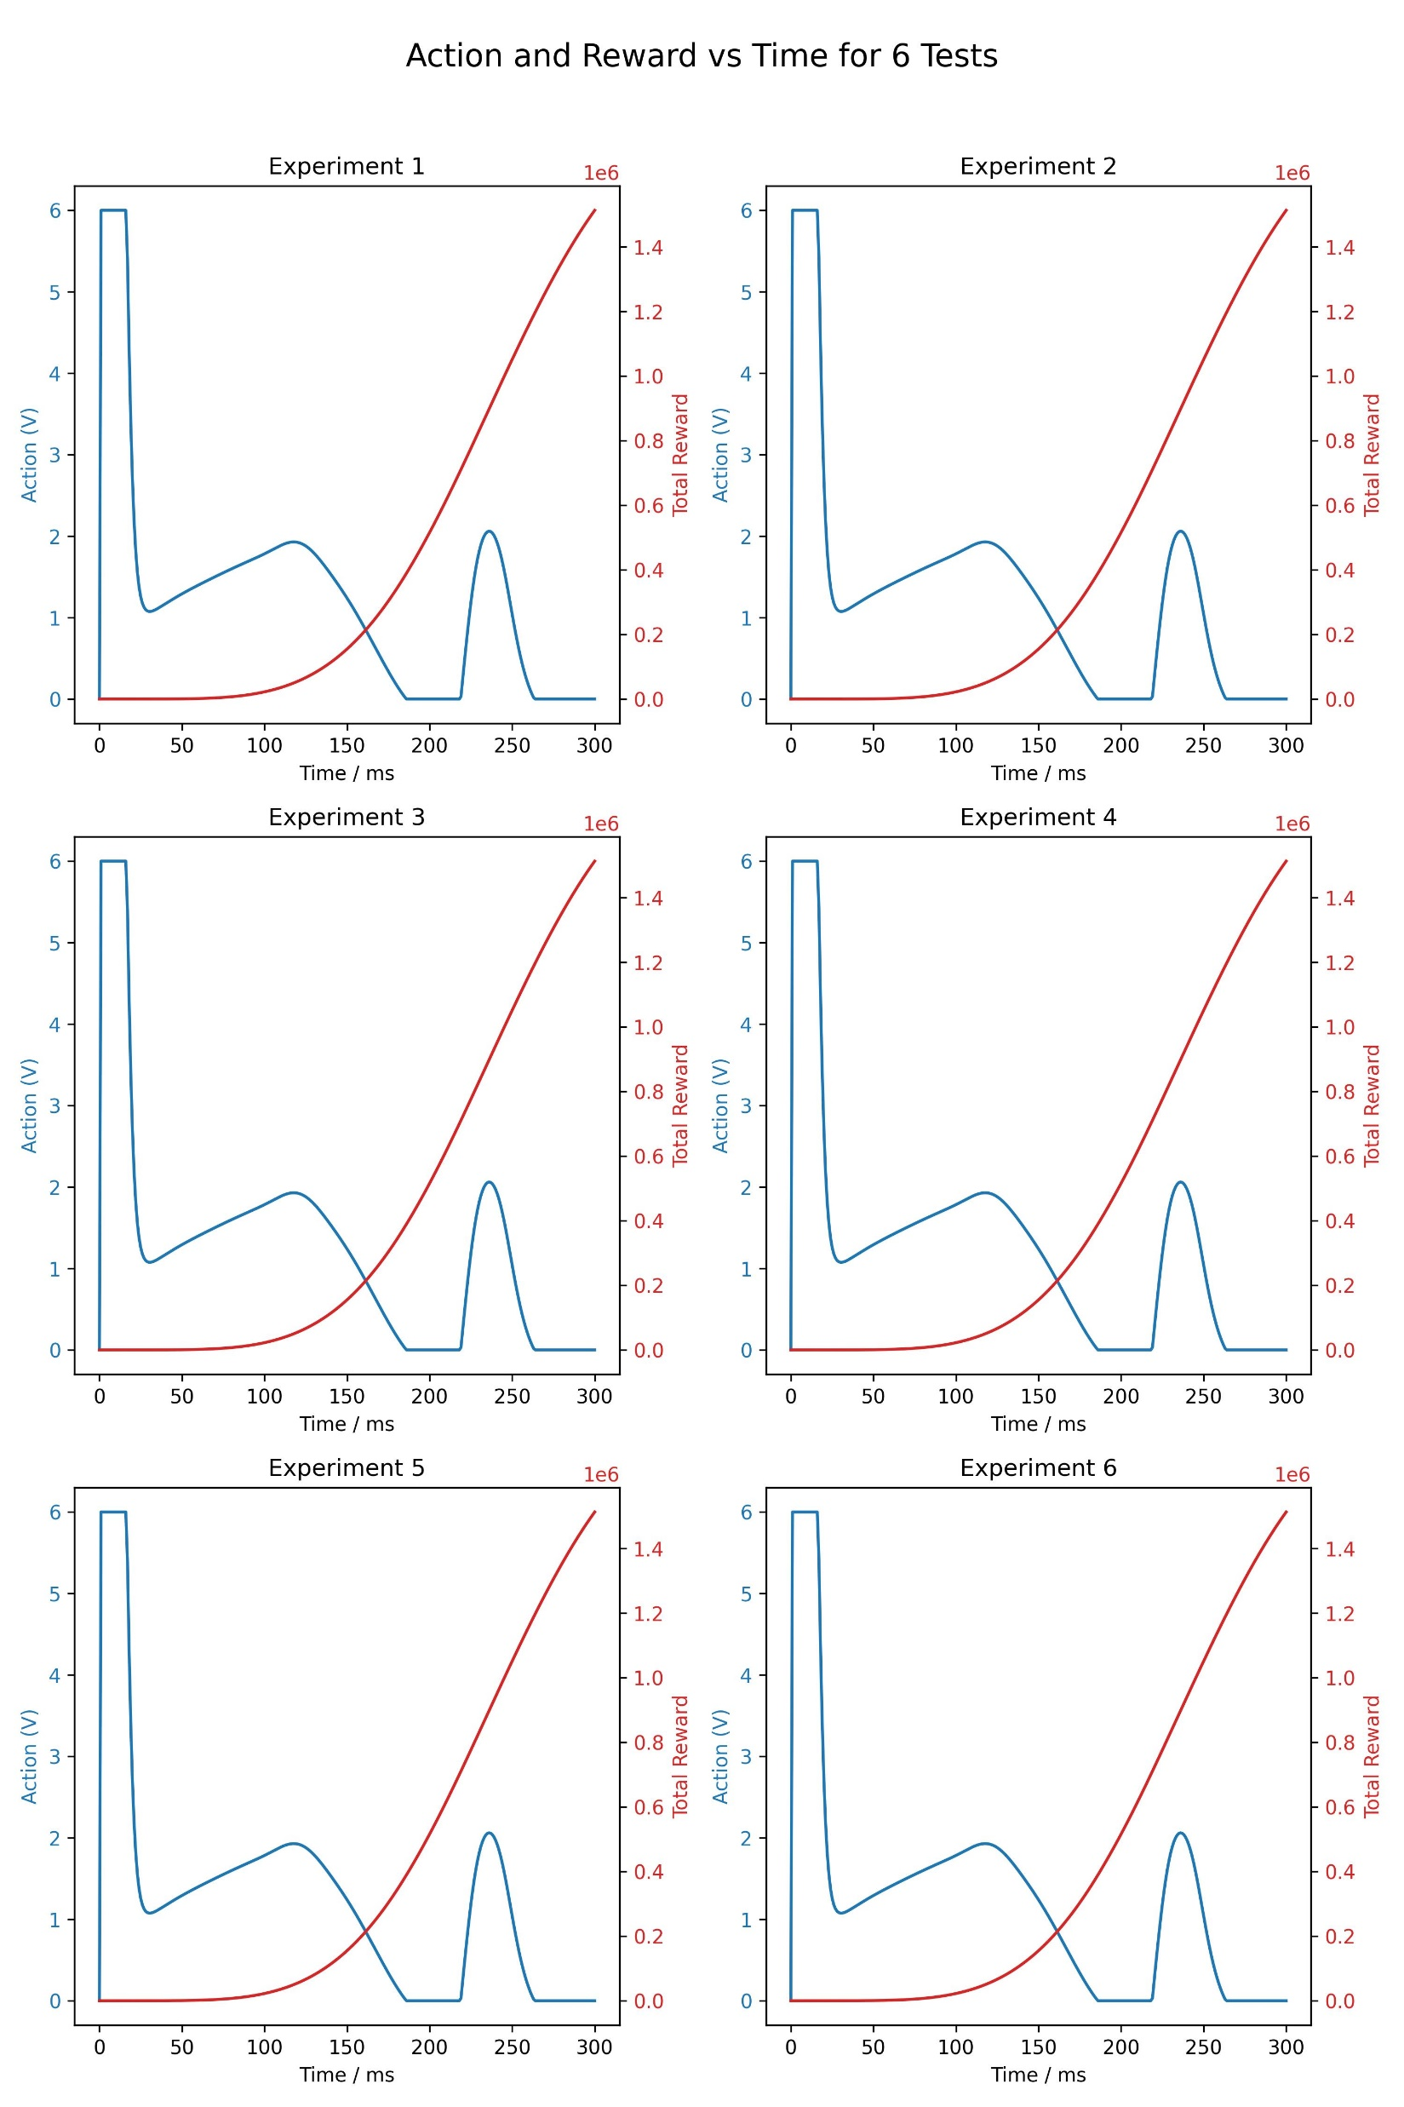
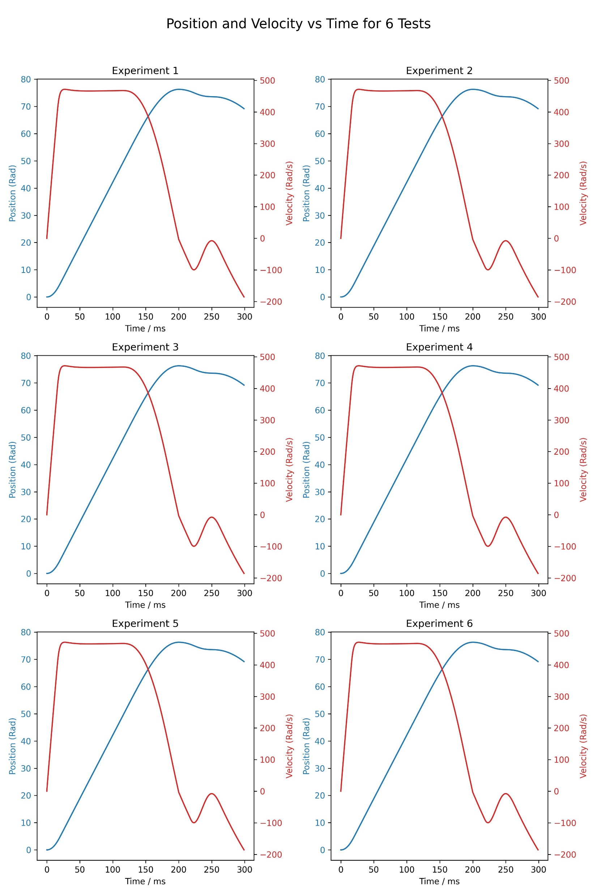
Train the model with fixed parameter

Slide 8
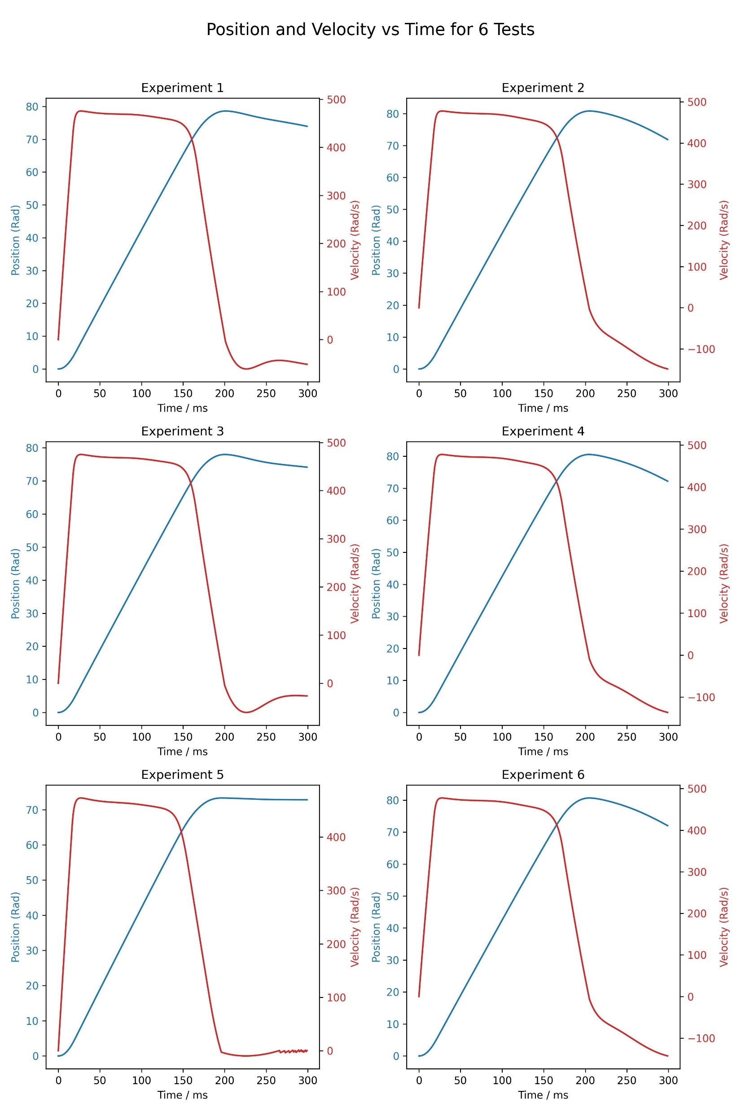
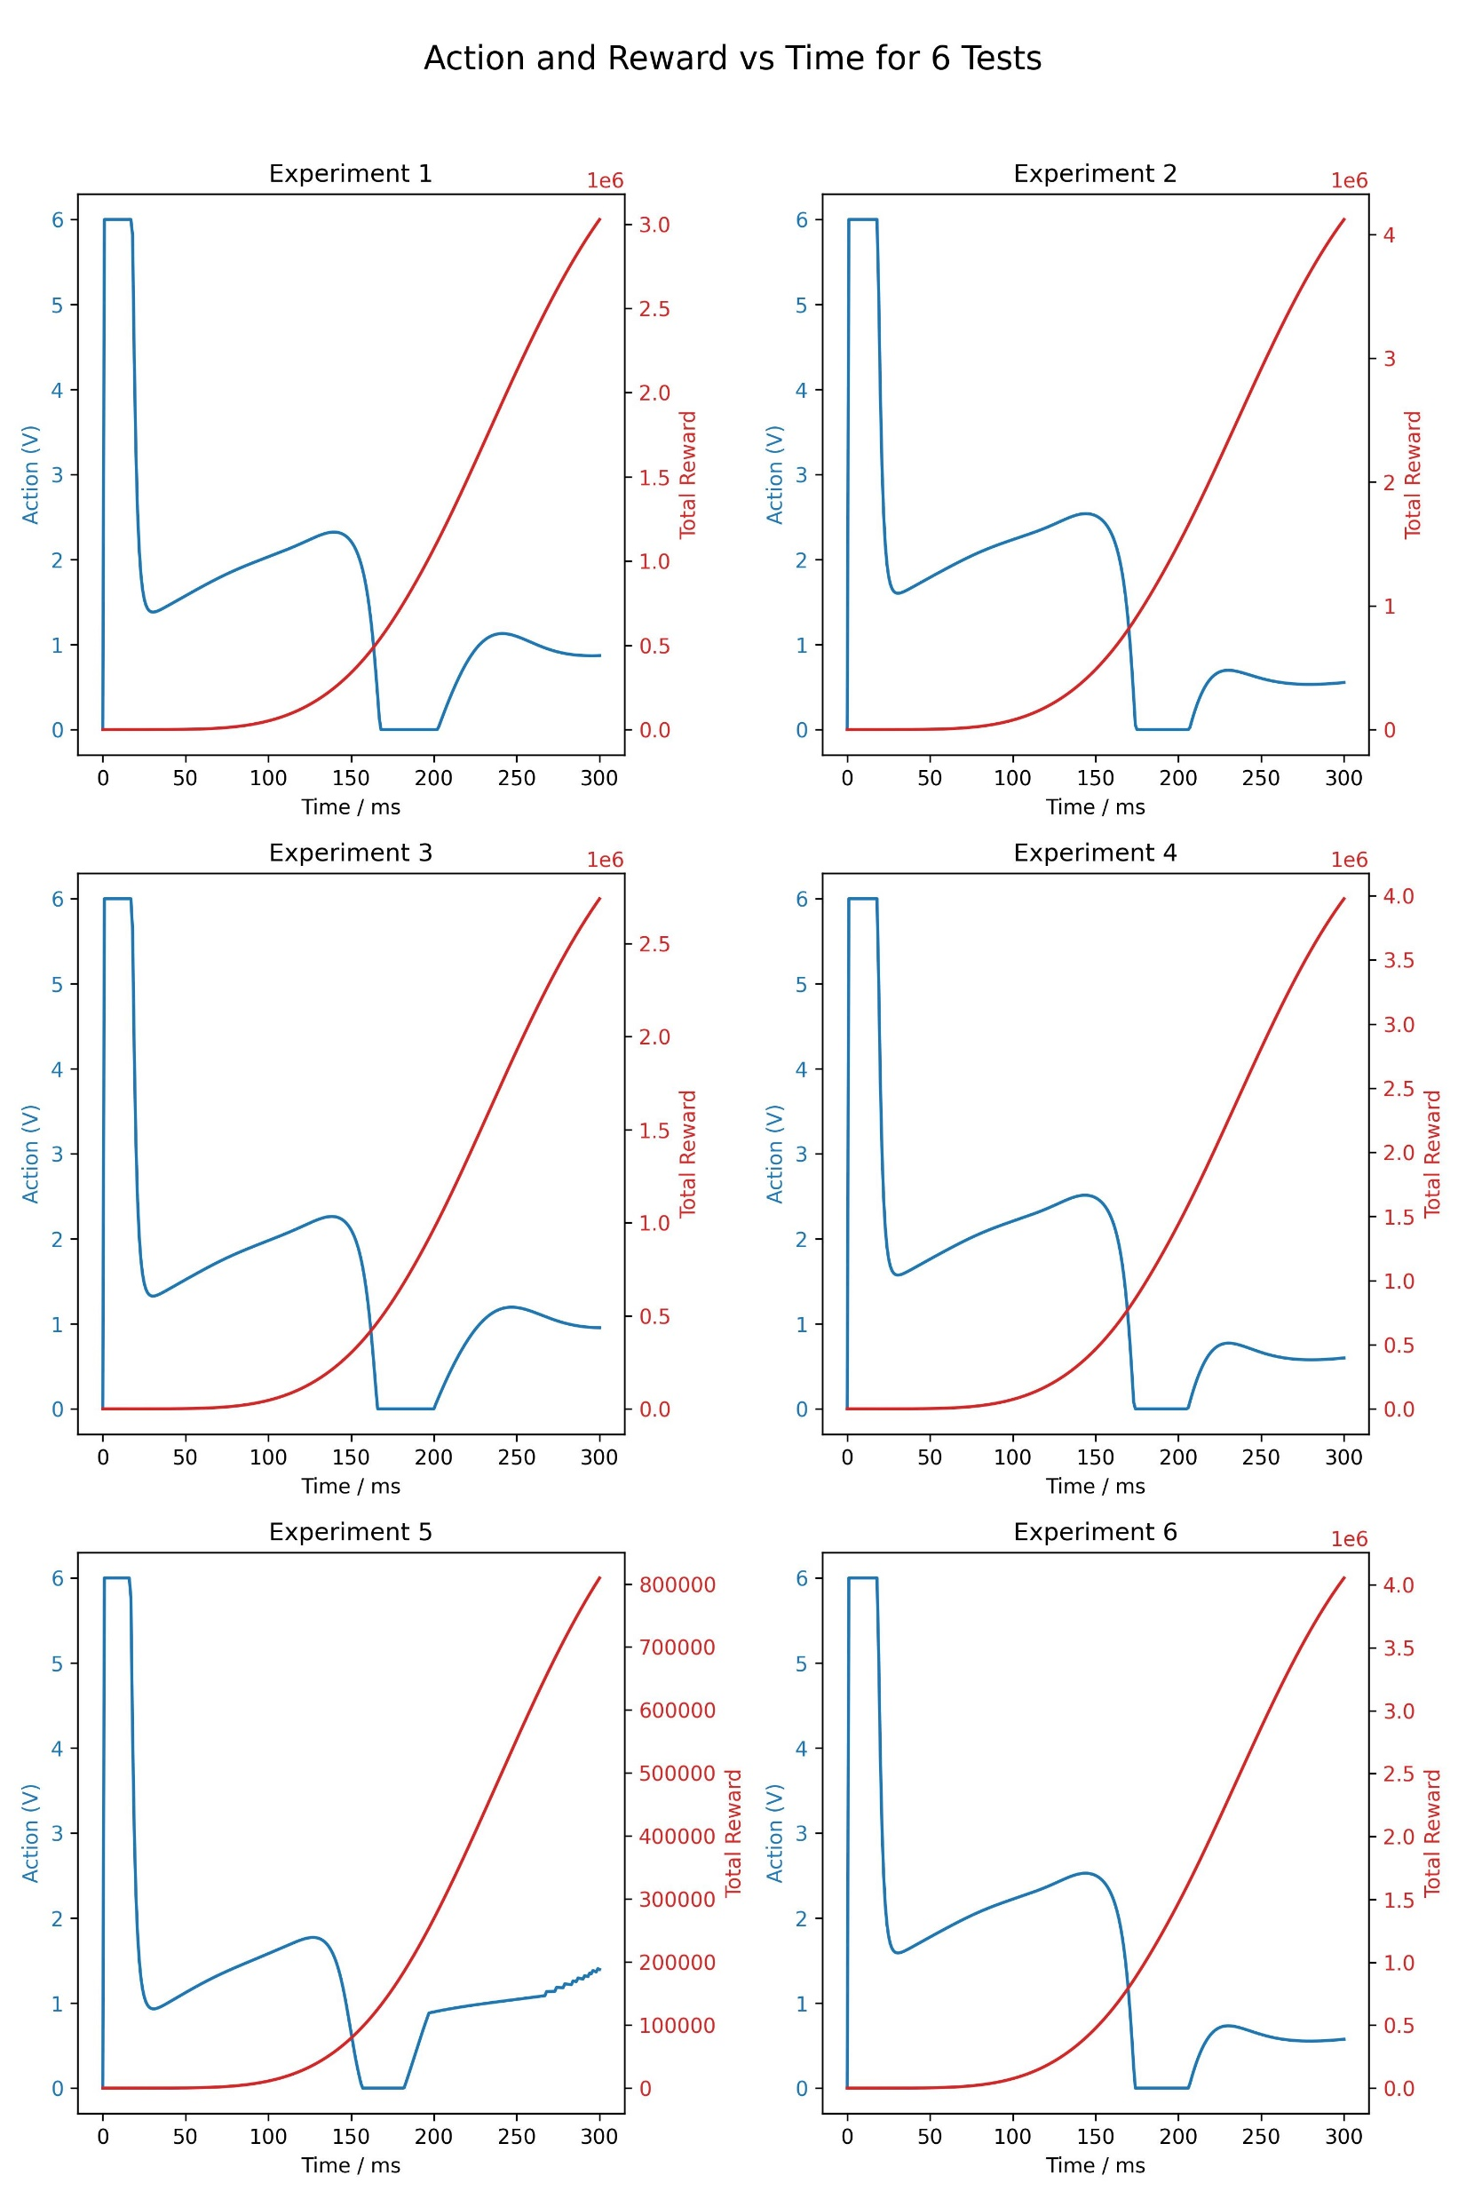
Train the model with sampled parameter
Include parameter to estimation in the env
Sample the parameter in each episode (from 1e-5 to 5e-5)

